Slide 1
PRODUCY DISPLAY
ZHUJI JIAYUUE IMPORT&EXPORT CO.,LTD.

Slide 2
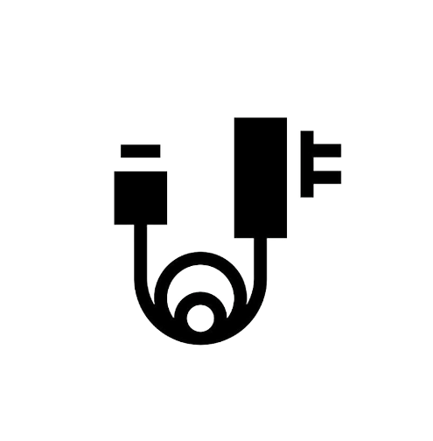
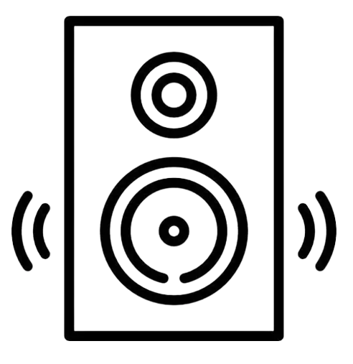
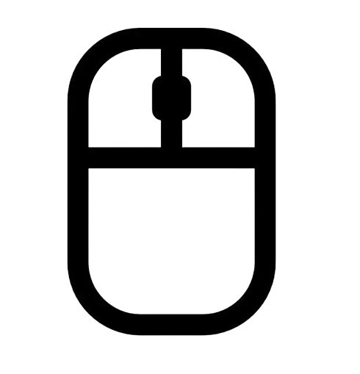
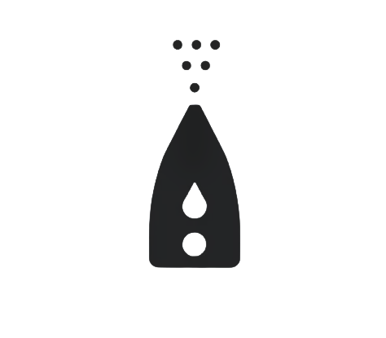
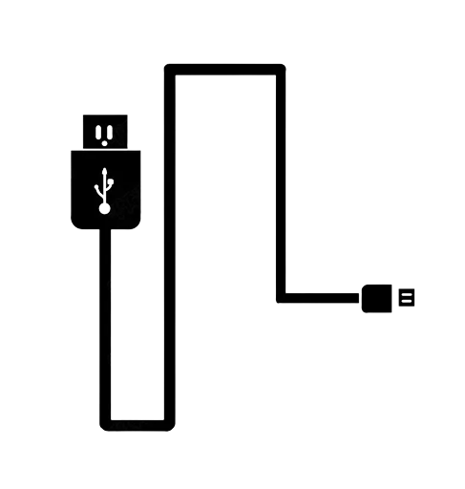
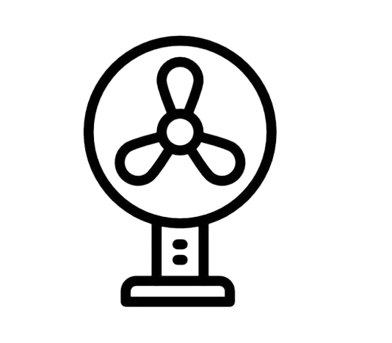
LIST
1
SPEAKER
2
EARPHONE
3
MOUSE
4
CHARGER
5
POWER
BANK
6
CABLE
7
HUMIDIFIER
8
FAN

Slide 3
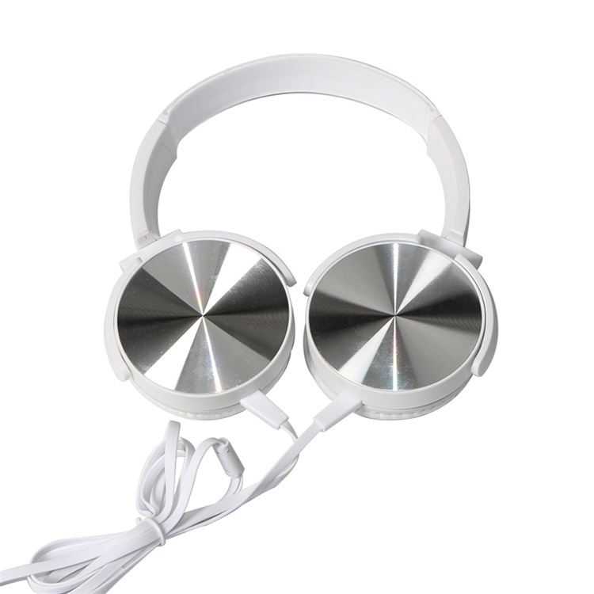
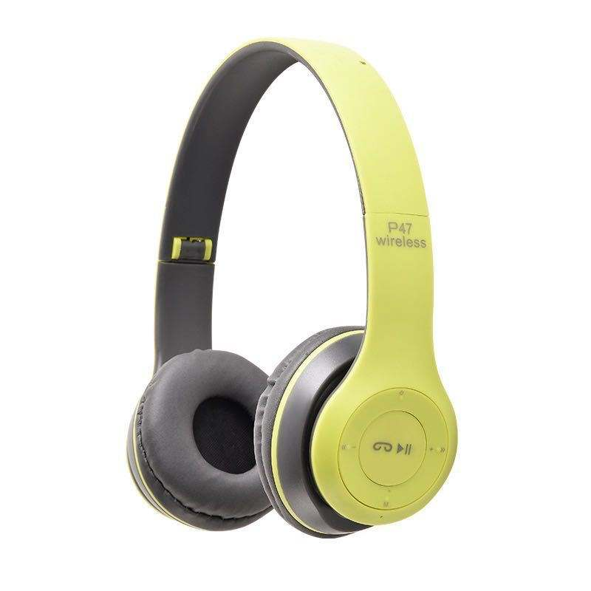
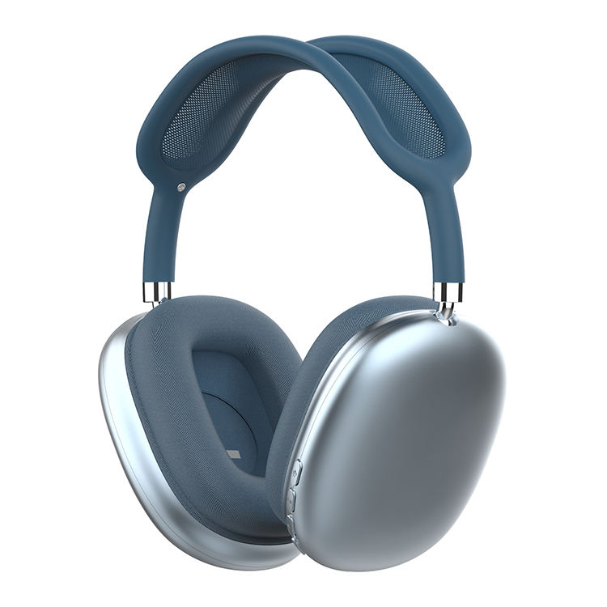
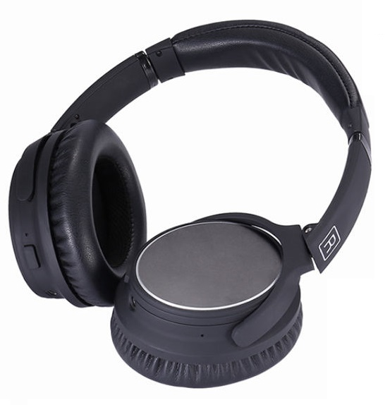
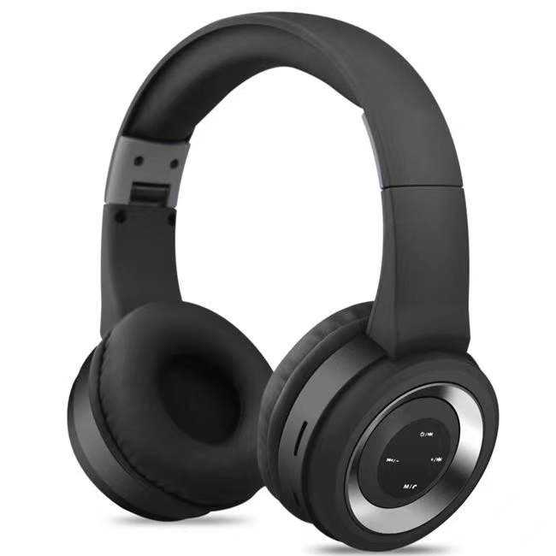
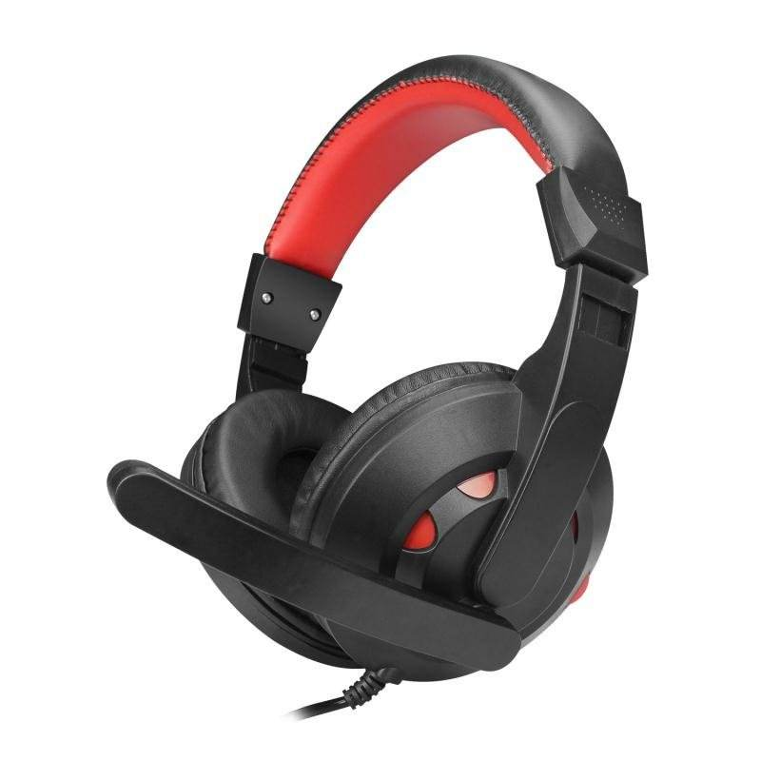
Let's go with music anytime
Let's go with music anytime
Wireless Headphone
Selective Color:
Material: Plastic:ABS
Speaker Diameter:30MM
Cable Length:1.2M
Rated Power:40mW
Sensitivity:103±3dB at 1000Hz
Plug type:3.5 mm stereo pin
type-c
Wireless Headphone
Selective Color:
Material: Plastic:ABS
Bluetooth Version: 5.0
Working distance: About 10m
Charging box capacity: 300mAh
Charging time: about 1-2 hour
Working time : about 5-8 hour
Input current: 5V 1A
EARPHONE
ITEM NO:
JYEA019
ITEM NO:
JYEA022
Wireless Headphone
Selective Color:
Material: Plastic:ABS
Bluetooth Version: 5.0
Working distance: About 10m
Charging box capacity: 400mAh
Charging time: about 1 hour
Working time : about 4-8 hours
Standby time: 120 hours
Wireless Headphone
Selective Color:
Material: Plastic:ABS
Bluetooth Version: V5.0+EDR
Working distance: About 10m
Charging box capacity: 600mAh
Charging time: about 2 hours
Working time : about 30-40 hours
Charging Cable: type-c
ITEM NO:
JYEA020
ITEM NO:
JYEA023
Wireless Headphone
Selective Color:
Material: Plastic:ABS, Faux Leather
Bluetooth Version: Bt 4.1+EDR
Working distance: About 10m
Charging box capacity: 400mAh
Charging time: about 4 hours
Working time : about 12hours
Call/play time: About Total 10 hours
Wireless Headphone
Selective Color:
Material: Plastic:ABS+PVC
Microphone impedance:2.2KΩ
Driver Diameter: Φ40.00mm
Frequency range: 20-20KHz
Speaker impedance:32Ω±15%
Speaker sensitivity: 95db±3dB
Cord lenght: 1.8m
Connectors: 3.5mm/ usb
ITEM NO:
JYEA021
ITEM NO:
JYEA024

Slide 4
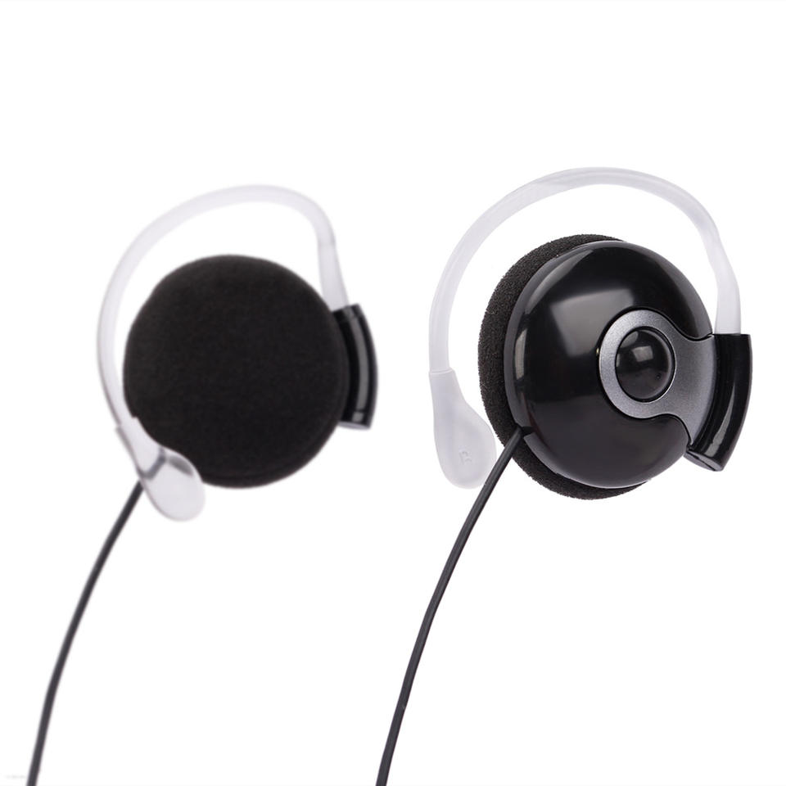
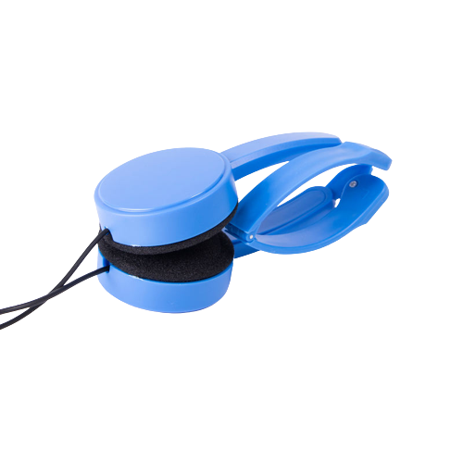
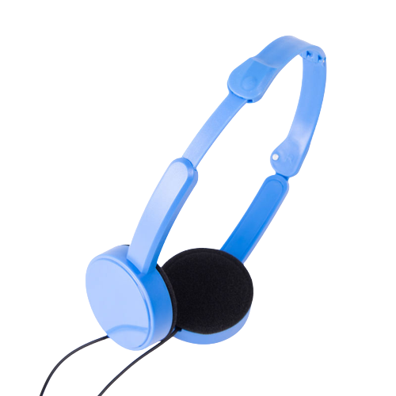
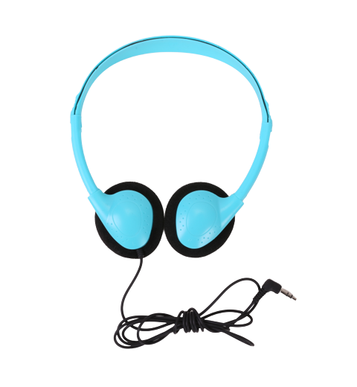
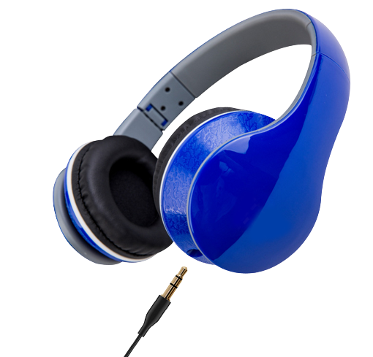
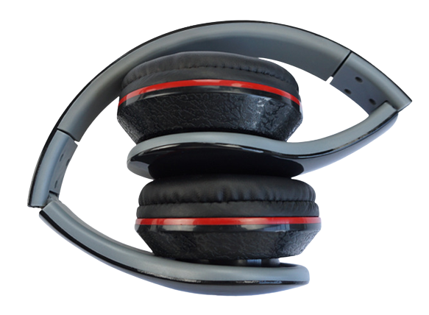
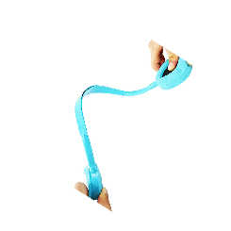
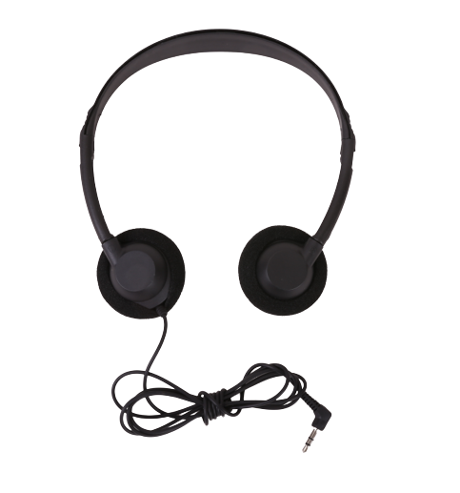
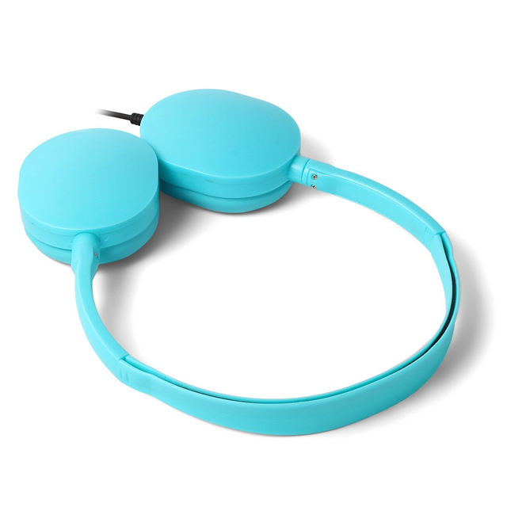
Let's go with music anytime
Let's go with music anytime
Disposable Stereo Earphones
Selective Color:
Material: Plastic:ABS
Speaker Diameter:30MM
Cable Length:1.2M
Rated Power:40mW
Sensitivity:103±3dB at 1000Hz
Plug type:3.5 mm stereo pin
Disposable Stereo Earphones
Selective Color:
Material: Plastic:ABS
Speaker Diameter:30MM
Cable Length:1.2M
Rated Power:40mW
Sensitivity:103±3dB at 1000Hz
Plug type:3.5 mm stereo pin
EARPHONE
ITEM NO:
JYEA007
ITEM NO:
JYEA010
Disposable Stereo Earphones
Selective Color:
Material: Plastic:ABS
Speaker Diameter:30MM
Cable Length:1.2M
Rated Power:40mW
Sensitivity:103±3dB at 1000Hz
Plug type:3.5 mm single pin Straight or ''L'' shape
3.5mm dual pin for airlines flight
3.5mmFoldable dual pin for airlines flight
Disposable Stereo Earphones
Selective Color:
Material: Plastic:ABS
Speaker Diameter:40MM
Cable Length:1.2M
Rated Power:40mW
Sensitivity:103±3dB at 1000Hz
Plug type: 3.5mm stereo pin
ITEM NO:
JYEA008
ITEM NO:
JYEA011
Disposable Stereo Earphones
Selective Color:
Material: Plastic:ABS
Speaker Diameter:30MM
Cable Length:1.2M
Rated Power:40mW
Sensitivity:103±3dB at 1000Hz
Plug type:3.5 mm single pin Straight or ''L'' shape
3.5mm dual pin for airlines flight
3.5mmFoldable dual pin for airlines flight
Disposable Stereo Earphones
Selective Color:
Material: Plastic:ABS
Speaker Diameter:30MM
Cable Length:1.2M
Rated Power:40mW
Sensitivity:103±3dB at 1000Hz
Plug type:3.5 mm single pin Straight or ''L'' shape
3.5mm dual pin for airlines flight
3.5mmFoldable dual pin for airlines flight
ITEM NO:
JYEA009
ITEM NO:
JYEA012

Slide 5
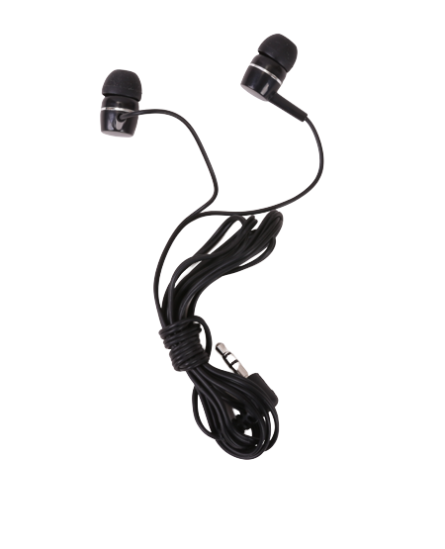
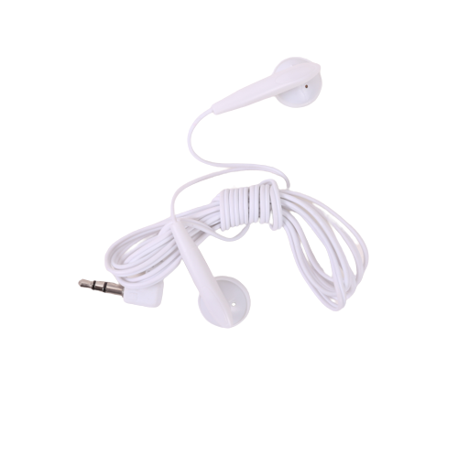
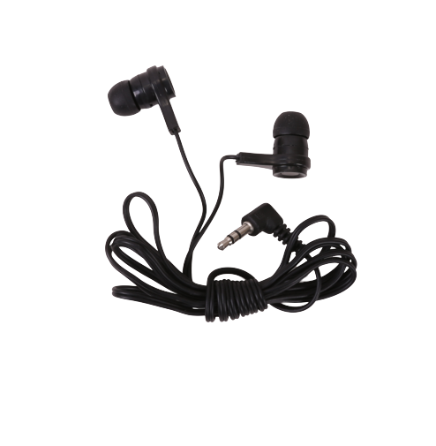
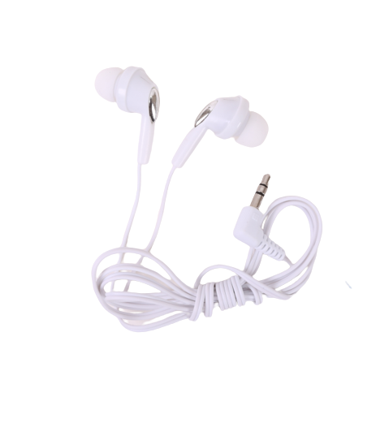
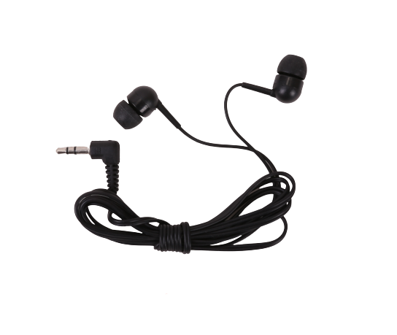
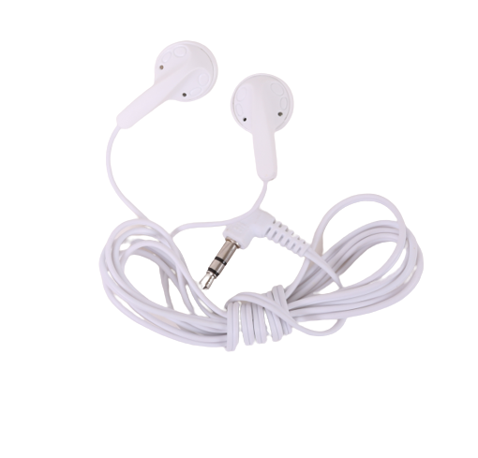
Let's go with music anytime
Let's go with music anytime
Disposable Stereo Earphones
Selective Color:
Material: Plastic:ABS+PVC
Speaker Diameter:10MM
Cable Length:1.2M
Plug type:3.5 mm single pin Straight or ''L'' shape
3.5mm dual pin for airlines flight
3.5mmFoldable dual pin for airlines flight
Disposable Stereo Earphones
Selective Color:
Material: Plastic:ABS+PVC
Speaker Diameter:10MM
Cable Length:1.2M
Plug type:3.5 mm single pin Straight or ''L'' shape
3.5mm dual pin for airlines flight
3.5mmFoldable dual pin for airlines flight
EARPHONE
ITEM NO:
JYEA001
ITEM NO:
JYEA004
Disposable Stereo Earphones
Selective Color:
Material: Plastic:ABS+PVC
Speaker Diameter:10MM
Cable Length:1.2M
Plug type:3.5 mm single pin Straight or ''L'' shape
3.5mm dual pin for airlines flight
3.5mmFoldable dual pin for airlines flight
Disposable Stereo Earphones
Selective Color:
Material: Plastic:ABS+PVC
Speaker Diameter:10MM
Cable Length:1.2M
Plug type:3.5 mm single pin Straight or ''L'' shape
3.5mm dual pin for airlines flight
3.5mmFoldable dual pin for airlines flight
ITEM NO:
JYEA002
ITEM NO:
JYEA005
Disposable Stereo Earphones
Selective Color:
Material: Plastic:ABS+PVC
Speaker Diameter:10MM
Cable Length:1.2M
Plug type:3.5 mm single pin Straight or ''L'' shape
3.5mm dual pin for airlines flight
3.5mmFoldable dual pin for airlines flight
Disposable Stereo Earphones
Selective Color:
Material: Plastic:ABS+PVC
Speaker Diameter:10MM
Cable Length:1.2M
Plug type:3.5 mm single pin Straight or ''L'' shape
3.5mm dual pin for airlines flight
3.5mmFoldable dual pin for airlines flight
ITEM NO:
JYEA003
ITEM NO:
JYEA006

Slide 6
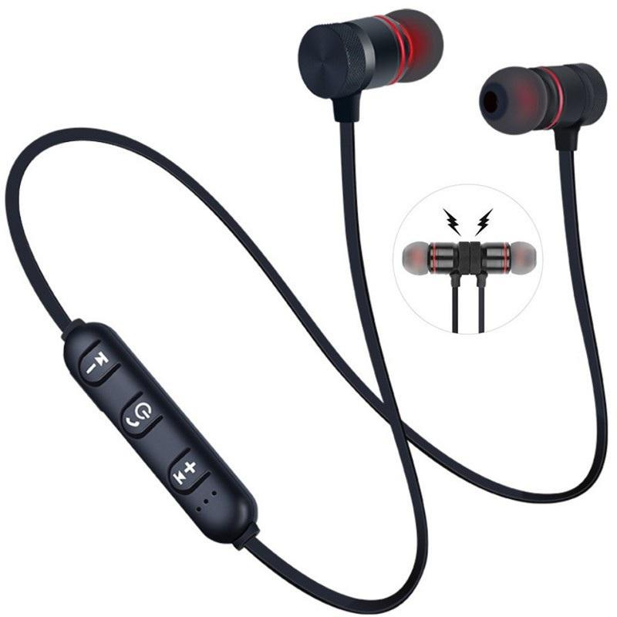
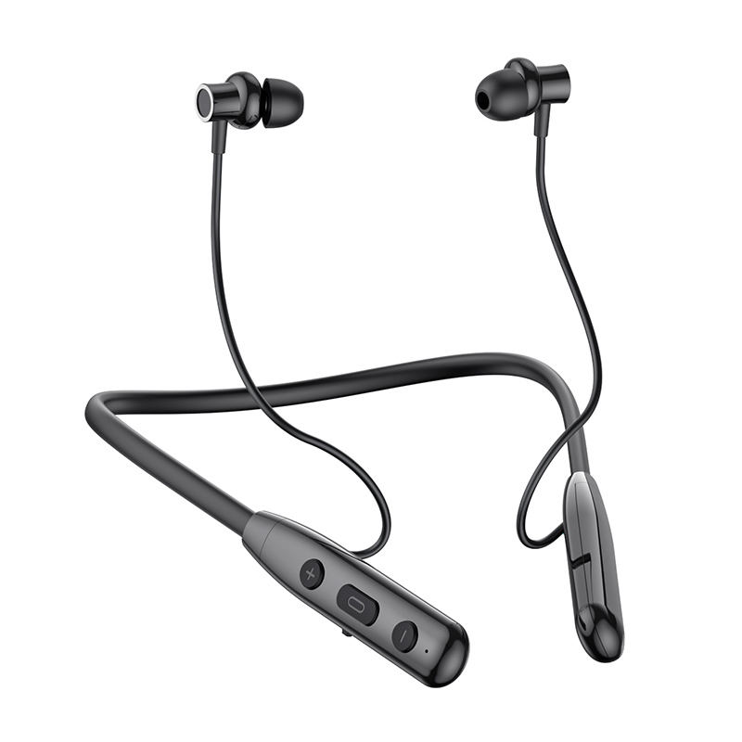
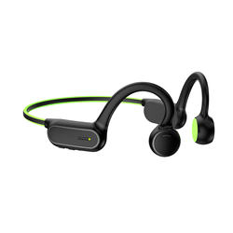
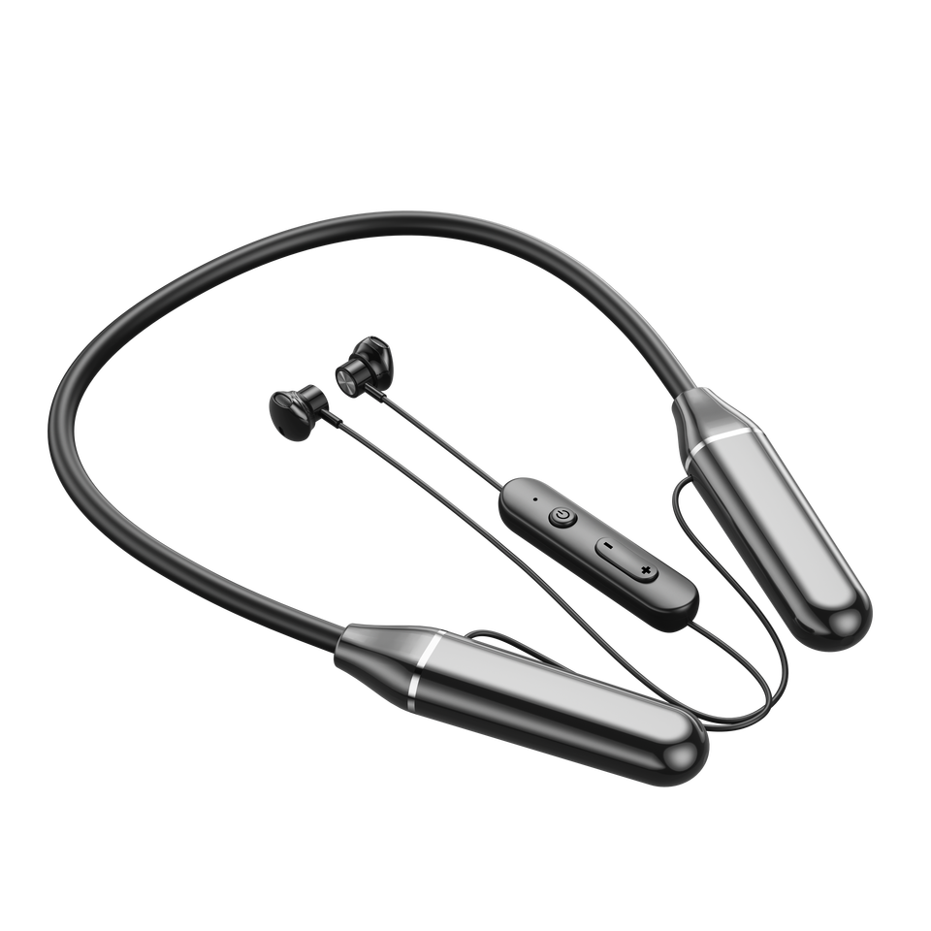
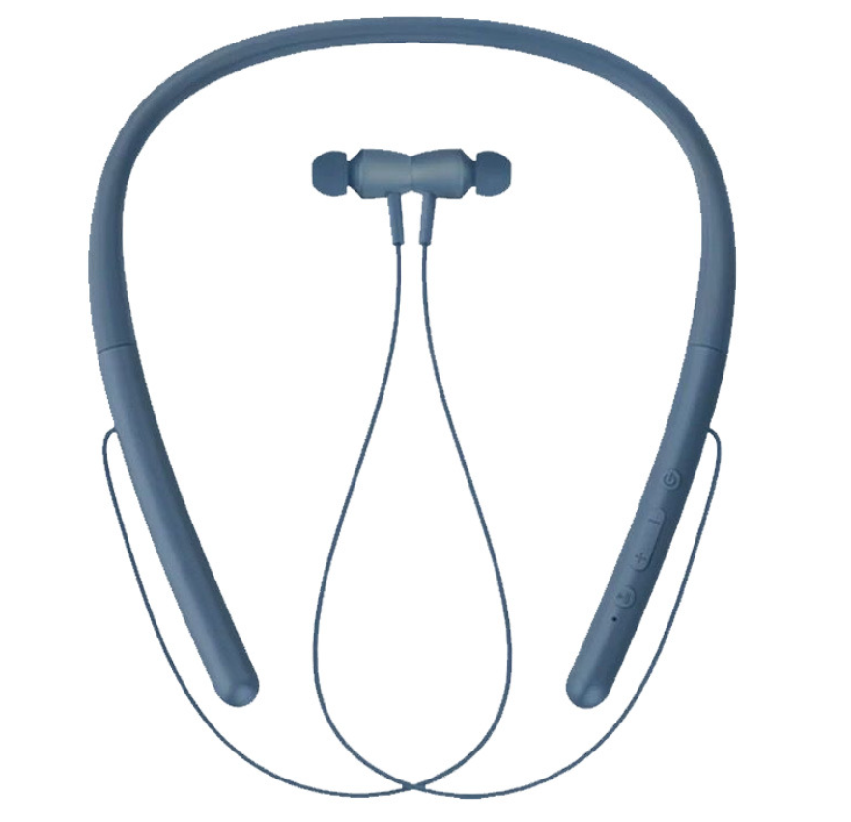
Let's go with music anytime
Let's go with music anytime
Wireless Neckband Headphone
Selective Color:
Material: Plastic:ABS
Bluetooth Version: 4.2
Working distance: About 10-15m
Charging box capacity: 300mAh
Standby time: About 240 hours
Call/play time: About Total 10 hours
Wireless Neckband Headphone
Selective Color:
Material: Plastic:ABS,PVC
Bluetooth Version: 5.3
Working distance: About 10-20m
Charging box capacity: 300mAh
Standby time: 365 days
Call/play time: About Total 50 hours
EARPHONE
ITEM NO:
JYEA013
ITEM NO:
JYEA016
Wireless Neckband Headphone
Selective Color:
Material: Plastic:ABS
Bluetooth Version: 4.2
Working distance: About 10-15m
Charging box capacity: 300mAh
Standby time: About 240 hours
Call/play time: About Total 10 hours
Wireless Neckband Headphone
Selective Color:
Material: Plastic:ABS
Bluetooth Version: 5.0
Working distance: About 10m
Charging box capacity: 230mAh
Standby time: About 300 hours
Call/play time: About 4-4.5 hours
ITEM NO:
JYEA014
ITEM NO:
JYEA017
Wireless Neckband Headphone
Selective Color:
Material: Plastic:ABS
Bluetooth Version: 5.1
Working distance: About 10m
Charging box capacity: 500mAh
Standby time: About 2000 hours
Call/play time: About Total 120 hours
Wireless Neckband Headphone
Selective Color:
Material: Plastic: Aluminum alloy
Bluetooth Version: 5.0
Working distance: About 10m
Charging box capacity: 300mAh
Standby time: About 240 hours
Call/play time: About Total 8 hours
ITEM NO:
JYEA015
ITEM NO:
JYEA018

Slide 7
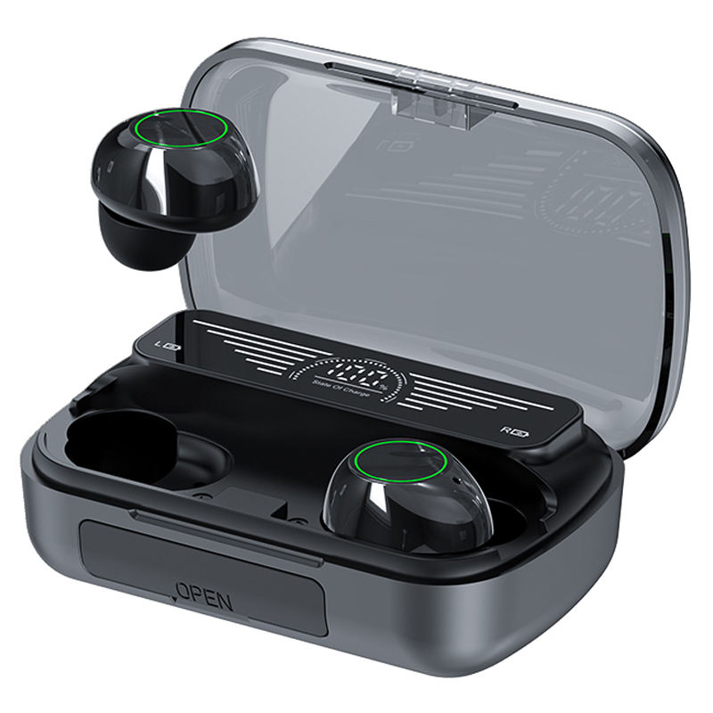
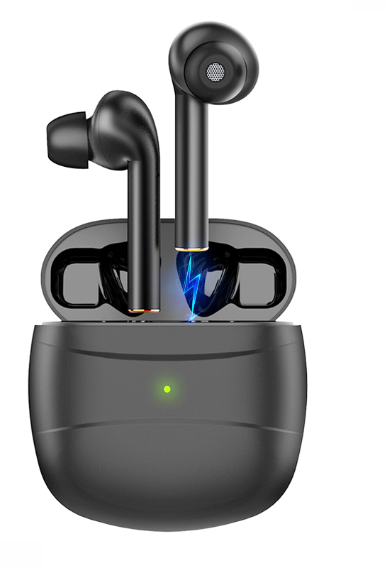
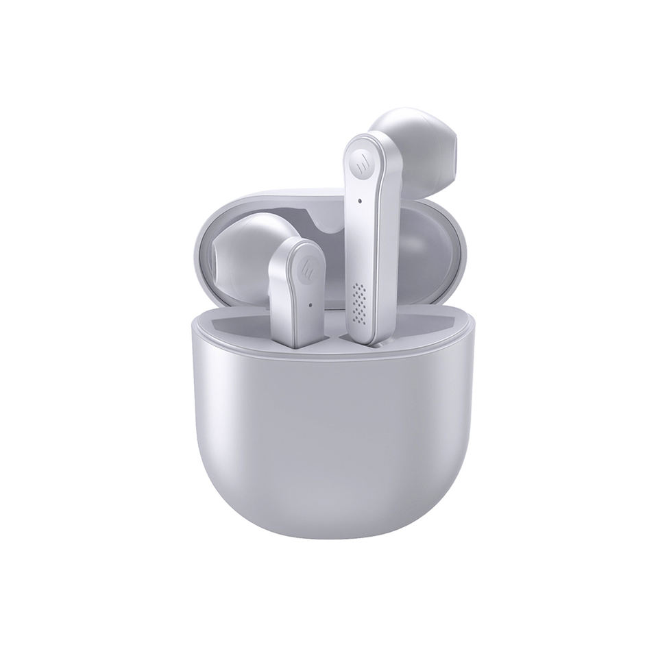
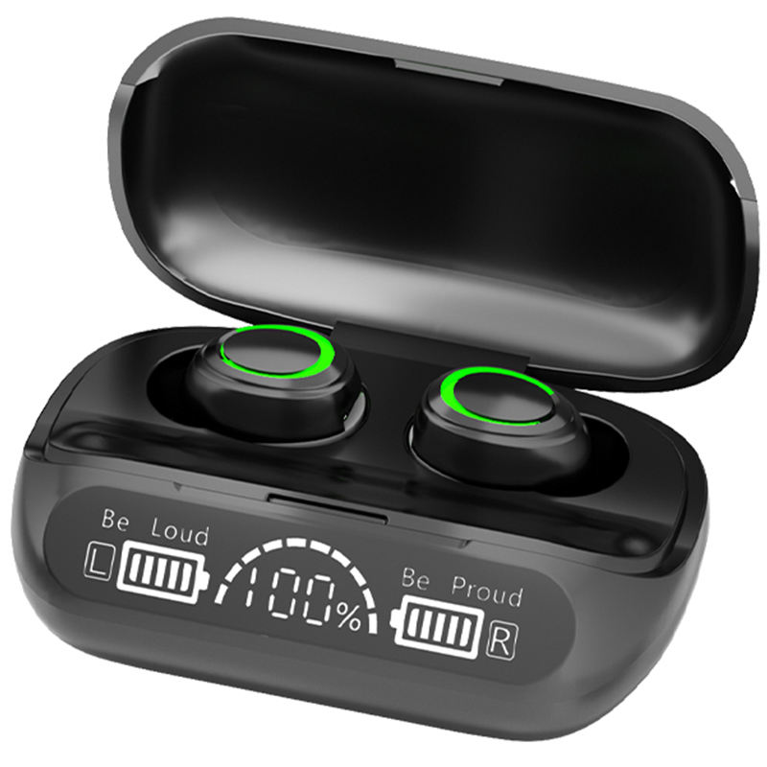
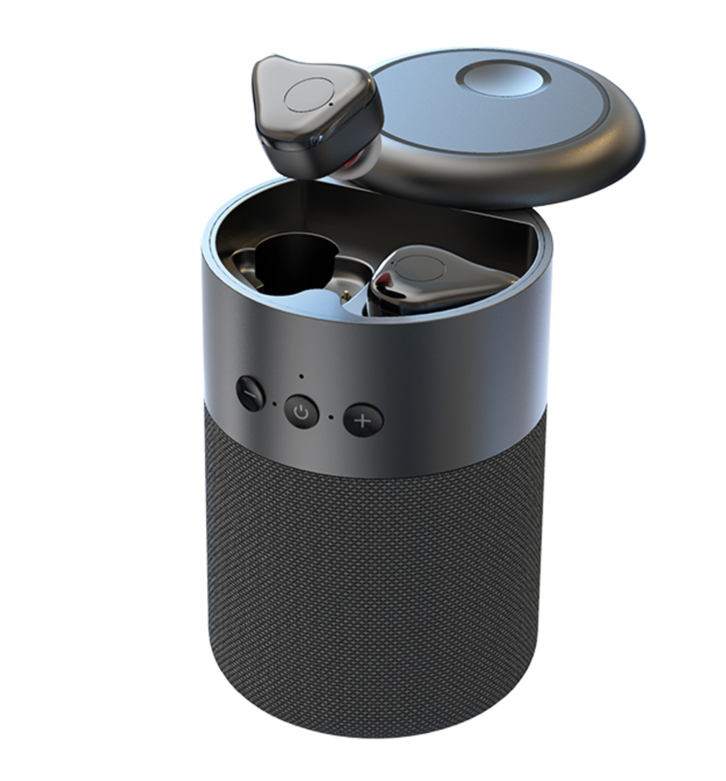
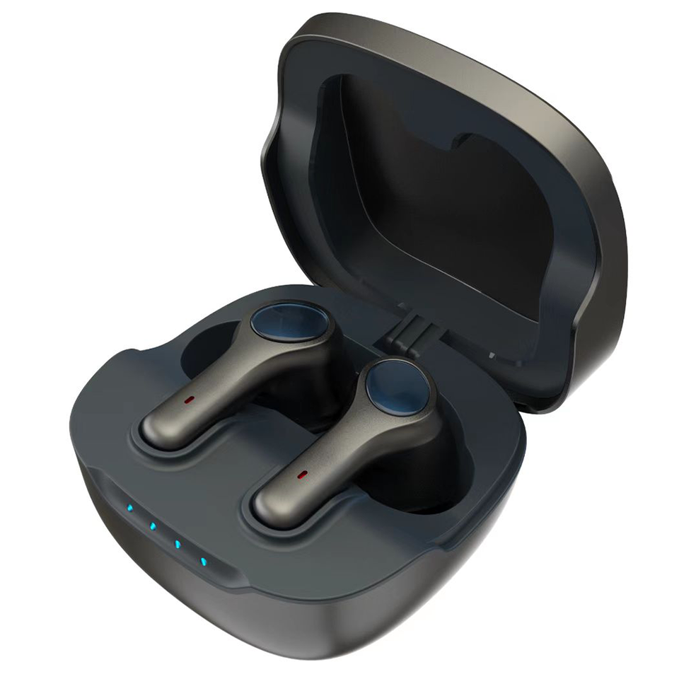
Let's go with music anytime
Let's go with music anytime
Wireless Headphone TWS
Selective Color:
Bluetooth version: 5.3
Wearing a way: In-ear wear
Standby time: 140 hours
Working time: 5-6 hours
Charging time: 1-2 hours
Charge warehourse capacity:1200mAh
The headset capacity: 50mAh
TRANS MISSION DISTANCE: 10M
Wireless Headphone TWS
Selective Color:
Bluetooth version: 5.0
Wearing a way: In-ear wear
Standby time: 96 hours
Working time: 4 hours
Charging time: 1-2 hours
Charge warehourse capacity:400mAh
The headset capacity: 50mAh
TRANS MISSION DISTANCE: 10M
EARPHONE
ITEM NO:
JYEA025
ITEM NO:
JYEA0289
Wireless Headphone TWS
Selective Color:
Bluetooth version: 5.1
Wearing a way: In-ear wear
Standby time: 5-6 hours
Working time: 5-6 hours
Charging time: 1-2 hours
Charge warehourse capacity:500mAh
The headset capacity: 40mAh
TRANS MISSION DISTANCE: 10M
Wireless Headphone TWS
Selective Color:
Bluetooth version: 5.0
Wearing a way: In-ear wear
Standby time: 50 hours
Working time: 3-4hours
Charging time: 1 hour
Charge warehourse capacity:200mAh
The headset capacity: 50mAh
TRANS MISSION DISTANCE: 10M
ITEM NO:
JYEA026
ITEM NO:
JYEA029
Wireless Headphone TWS
Selective Color:
Bluetooth version: 5.1
Wearing a way: In-ear wear
Standby time: ≥100 hours
Working time: 5-6 hours
Charging time: 1-1.5 hours
Charge warehourse capacity:380mAh
The headset capacity: 40mAh
TRANS MISSION DISTANCE: 10M
Wireless Headphone TWS&Speaker
Selective Color:
Bluetooth version: 5.0
Wearing a way: In-ear wear
Standby time: ≥100 hours
Working time: 5-6 hours
Charging time: 1-1.5 hours
Charge warehourse capacity:600mAh
The headset capacity: 40mAh
TRANS MISSION DISTANCE: 10M
ITEM NO:
JYEA027
ITEM NO:
JYEA030

Slide 8
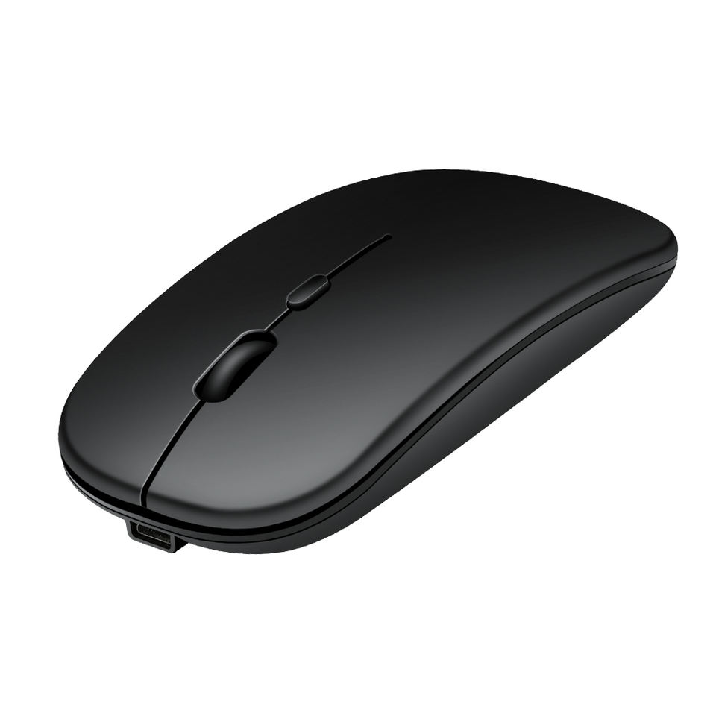
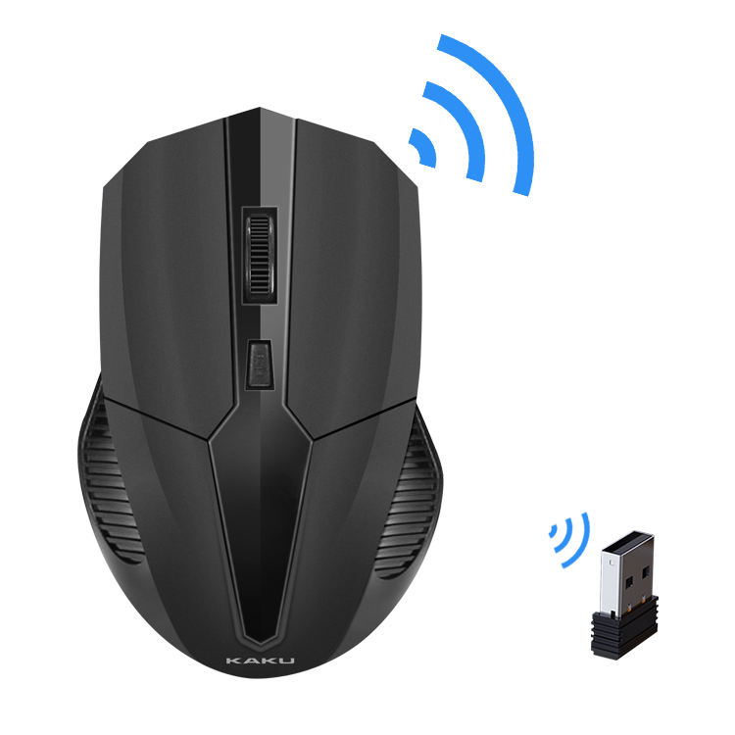
Let's go with music anytime
Let's go with music anytime
Wireless Mouse
Selective Color:
Bluetooth version: 5.0
Buttons: 4 buttons
The Max DPI:1600 DPI
Ajustable DPI Switch: 800 /1200 /1600DPI
WiFi Range: 10M
Battery: Rechargeable
Charging Cable Length: About 20cm
Switch Life: 10 Million Times
Wireless Mouse
Selective Color:
Type: 2.4Ghz Wireless
Buttons: 4 buttons
DPI:1200 DPI
WiFi Range: 10M
Battery: Rechargeable
Interface Type: USB
Switch Life: 10 Million Times
MOUSE
ITEM NO:
JYMO001
ITEM NO:
JYMO0049
Wireless Mouse
Selective Color:
Transmission: Cable USB
Breathing light: bright color LED
Number of keys: 6 keys
The Max DPI:4000 DPI
Ajustable DPI Switch: 1000 /1500 /4000DPI
Cable Length: 1.5m
Switch Life: 10 Million Times
Wireless Mouse
Selective Color:
Type: 2.4Ghz Wireless
Buttons: 4 buttons
DPI:1200 DPI
WiFi Range: 10M
Battery: Rechargeable
Interface Type: USB
Switch Life: 10 Million Times
ITEM NO:
JYEMO002
ITEM NO:
JYMO005
Wireless Mouse
Selective Color:
Transmission: Cable USB
Breathing light: bright color LED
Number of keys: 6 keys
The Max DPI:2000 DPI
Ajustable DPI Switch: 1000 /1500 /2000DPI
Cable Length: 1.5m
Switch Life: 10 Million Times
Wireless Mouse
Selective Color:
Type: 2.4Ghz Wireless
Buttons: 4 buttons
The Max DPI:1500 DPI
Ajustable DPI Switch: 800 /1200 /1500DPI
WiFi Range: 10M
Battery: Rechargeable
Charging Cable Length: About 20cm
Switch Life: 10 Million Times
ITEM NO:
JYMO003
ITEM NO:
JYMO006

Slide 9
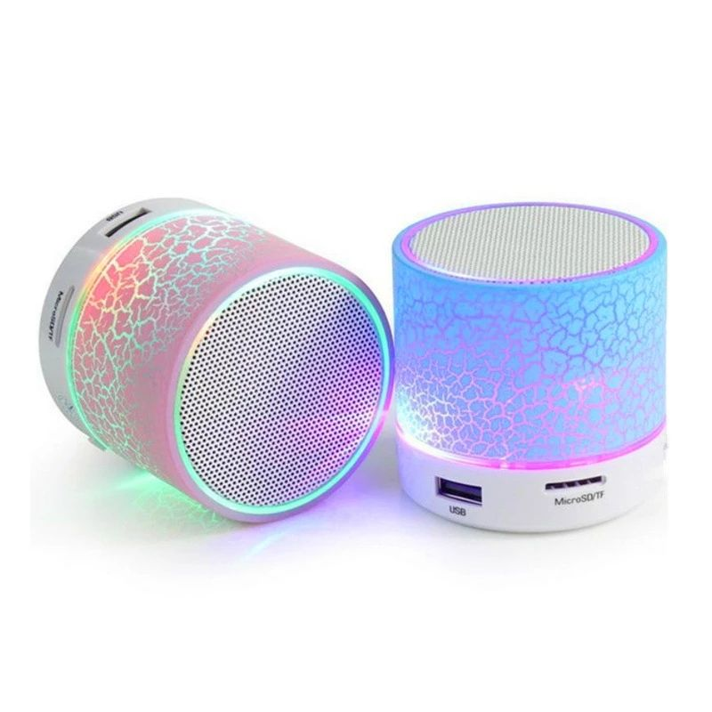
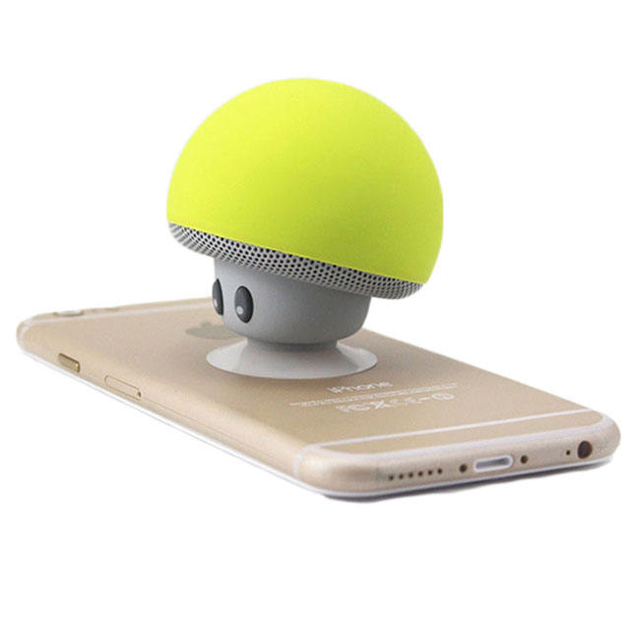
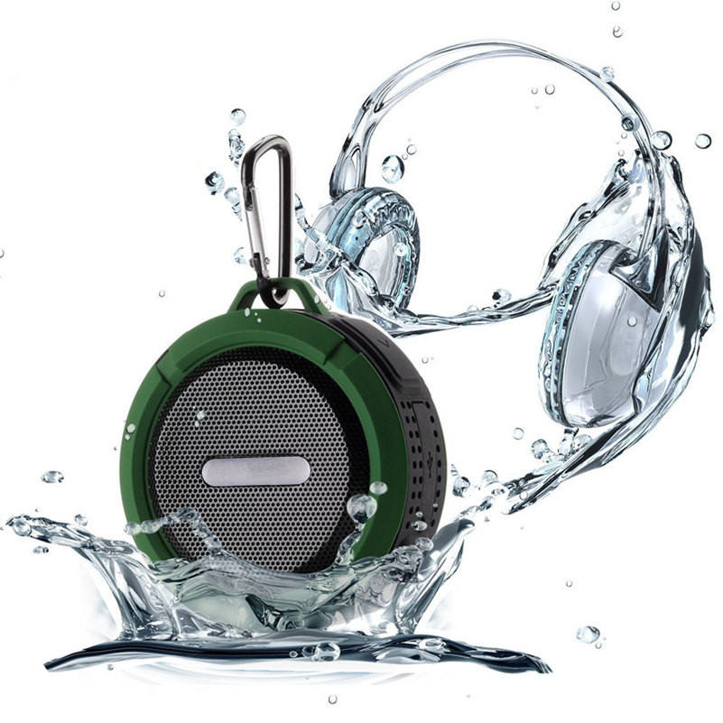
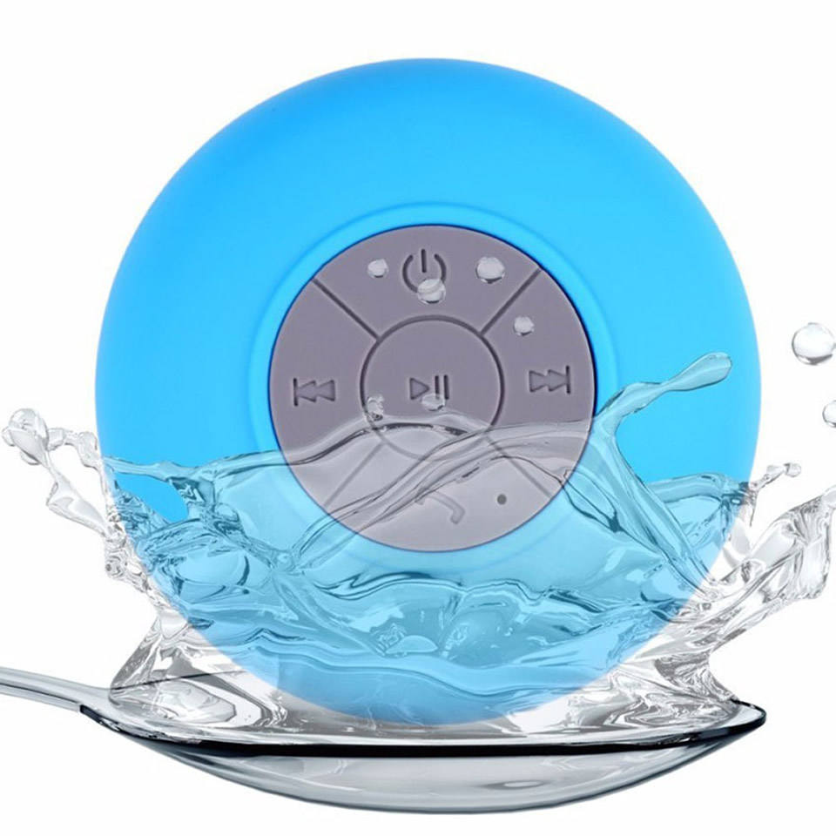
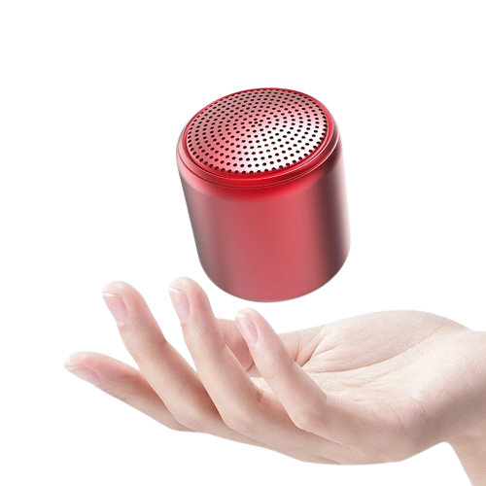
Let's go with music anytime
Let's go with music anytime
Portable Bluetooth Speaker
Selective Color:
Material: ABS+Silicone
Bluetooth Version: V4.2
Battery capacity:280mAh
Output power:3W
Dimension:φ55*55mm
Supporting:Bluetooth
QTY: 100PCS
N.W:15 KGS G.W: 16 KGS
MEAS: 42*42*42cm
Portable Bluetooth Speaker
Selective Color:
Material: ABS ,Plastic
Bluetooth Version:V4.2
Battery capacity:400mAh
Output power:3W
Dimension:φ58*52mm
Supporting:TF,SD Card,AUX,Bluetooth
QTY: 100 PCS
N.W:12.5 KGS G.W: 13.8 KGS
MEAS: 32.8*32.8*29.8cm
BLUETOOTH
SPEAKER
ITEM NO:
JYSO001
ITEM NO:
JYSO004
Portable Bluetooth Speaker
Selective Color:
Material: Aluminum, ABS
Bluetooth Version:V5.0+EDR
Battery capacity:300mAh
Output power:3W
Dimension:95*86*35mm
Supporting:Bluetooth,AUX, usb, Audio Line
QTY: 100PCS
N.W:16KGS G.W: 18KGS
MEAS:58*24*46cm
Portable Bluetooth Speaker
Selective Color:
Material: Plastic
Bluetooth Version:V3.0+EDR
Battery capacity:400mAh
Output power:3W
Dimension:φ85*45mm
Supporting:Bluetooth
QTY: 50PCS
N.W:7.5KGS G.W: 8.5KGS
MEAS:45*19*25cm
ITEM NO:
JYSO002
ITEM NO:
JYSO005
Portable Bluetooth Speaker
Selective Color:
Material: ABS ,Plastic
Bluetooth Version:V5.0
Battery capacity:400mAh
Output power:5W
Dimension:φ36*36mm
Supporting:Bluetooth
QTY: 100PCS
N.W:10 KGS G.W: 11 KGS
MEAS: 53*35*15cm
Portable Bluetooth Speaker
Selective Color:
Material: Aluminium alloy ,plastic,iron mesh
Bluetooth Version:RDA3.0
Battery capacity:300mAh
Output power:3W
Dimension:φ68*52mm
Supporting:TF,FM,USB,Bluetooth
QTY: 100 PCS
N.W:12 KGS G.W: 12.7 KGS
MEAS: 39*39*37cm
ITEM NO:
JYSO003
ITEM NO:
JYSO006

Slide 10
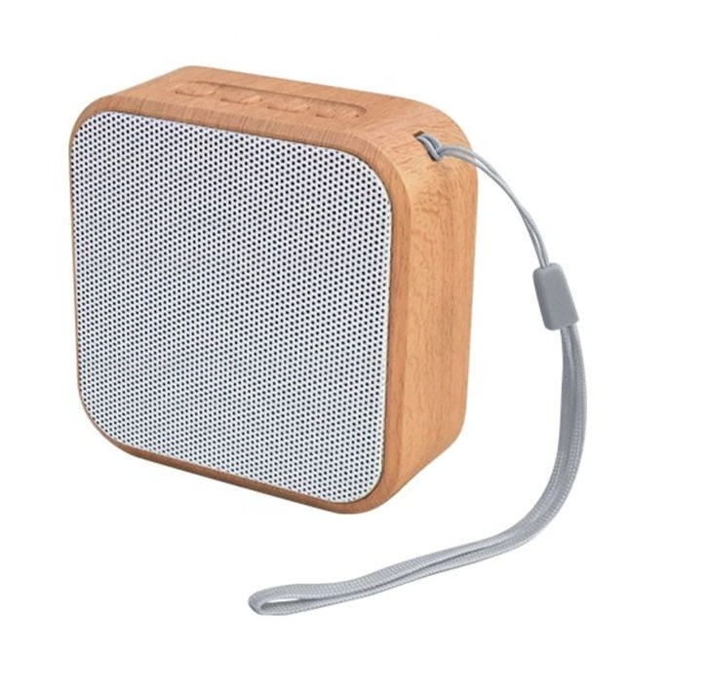
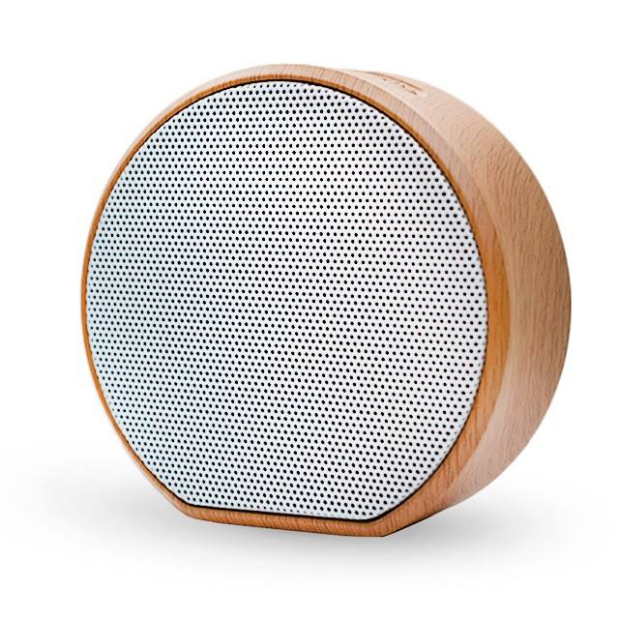
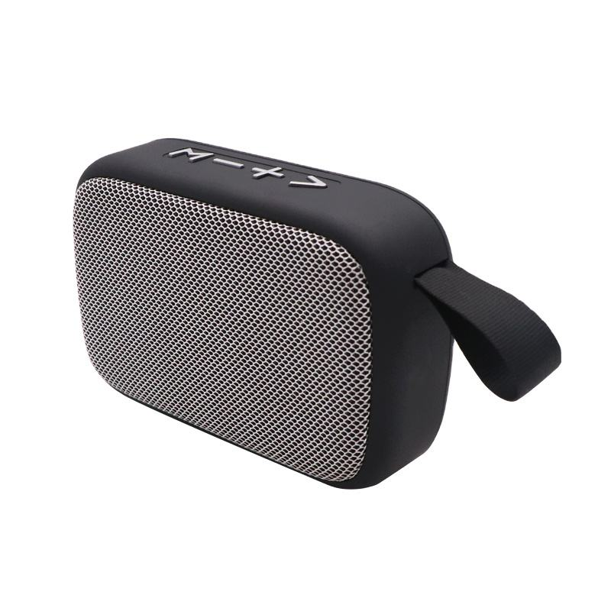
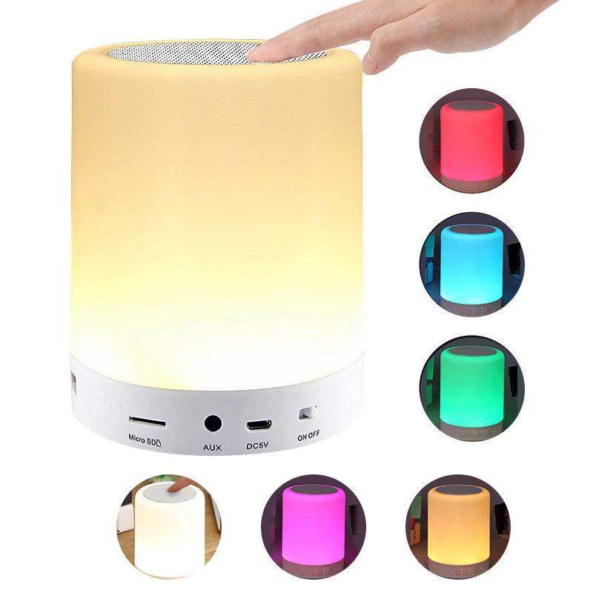
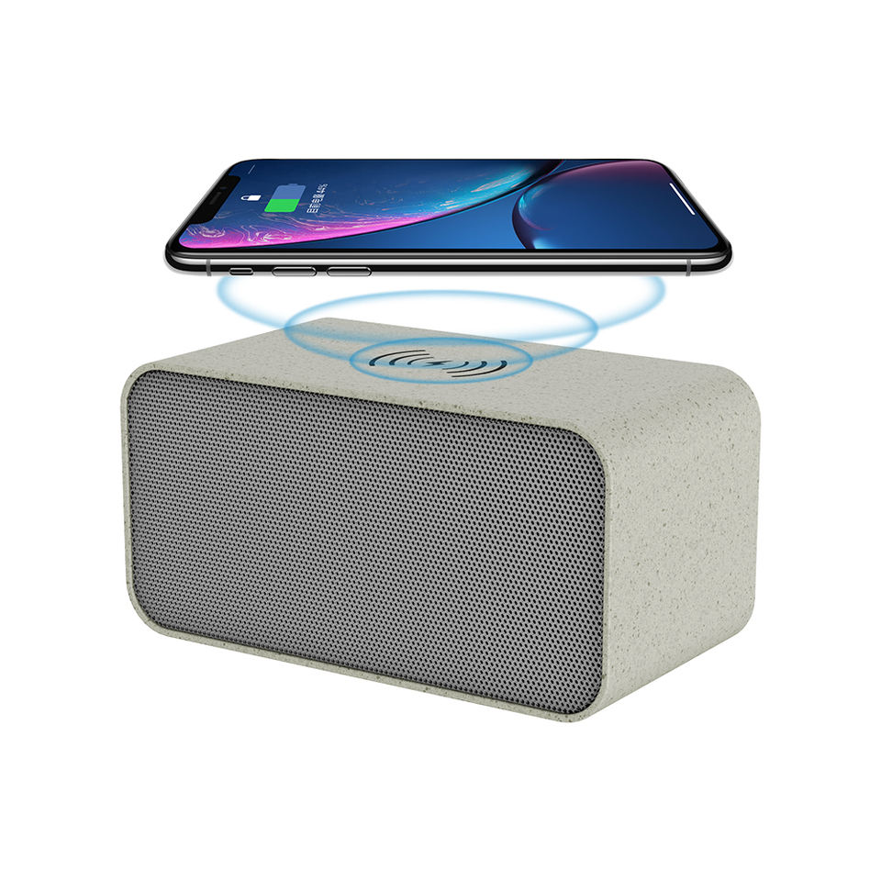
Let's go with music anytime
Let's go with music anytime
BLUETOOTH
SPEAKER
Portable Bluetooth Speaker
Selective Color:
Material: Wood,Plastic
Bluetooth Version: V4.2
Battery capacity:600mAh
Output power:3W
Dimension:82*35*81mm
Supporting:Bluetooth,TF,AUX
QTY: 100PCS
N.W:24 KGS G.W: 25 KGS
MEAS: 46*27*49cm
Portable Bluetooth Speaker
Selective Color:
Material: Wood,Plastic
Bluetooth Version:V4.1
Battery capacity:400mAh
Output power:3W
Dimension:φ85*35mm
Supporting:USB,AUX,Bluetooth
QTY: 100 PCS
N.W:24KGS G.W: 25KGS
MEAS: 43*43*44.5cm
ITEM NO:
JYSO007
ITEM NO:
JYSO010
Portable Bluetooth Speaker
Selective Color:
Material: ABS ,Fabric
Bluetooth Version:V5.0
Battery capacity:300mAh
Output power:3W
Dimension:120*35*70mm
Supporting:TF,FM,Bluetooth
QTY: 100 PCS
N.W:21.8 KGS G.W: 22.8KGS
MEAS: 43*29.5*42.5cm
Portable Bluetooth Speaker
Selective Color:
Material: ABS ,Plastic
Bluetooth Version:V5.0
Battery capacity:600mAh
Output power:RMS 3W
Dimension:φ96*127mm
Supporting:TF,FM,AUX,Bluetooth
QTY: 40 PCS
N.W:12.5 KGS G.W: 13.4 KGS
MEAS: 56.5*33*38.2cm
ITEM NO:
JYSO008
ITEM NO:
JYSO011
Portable Bluetooth Speaker
Selective Color:
Material: ABS
Bluetooth Version:V5.0
Battery capacity:400mAh
Output power:3W
Dimension:108*56*54mm
Supporting:Bluetooth,AUX
QTY: 40PCS
N.W:9KGS G.W: 11.4 KGS
MEAS:36*28*35cm
Portable Bluetooth Speaker
Selective Color:
Material: Aluminium ,Plastic
Bluetooth Version:4.0 HTX
Battery capacity:1200mAh
Output power:10W
Dimension:205*85*50mm
Supporting:AUX, usb, Audio Line,Bluetooth
QTY: 50 PCS
N.W:26.8 KGS G.W:27.8 KGS
MEAS: 45*31*48.5cm
ITEM NO:
JYSO009
ITEM NO:
JYSO012

Slide 11
Let's go with music anytime
Let's go with music anytime
BLUETOOTH
SPEAKER
Portable Bluetooth Speaker
Selective Color:
Material: Plastic
Bluetooth Version: V5.0
Battery capacity:800mAh
Output power:5W
Dimension:138*88*42mm
Supporting:Bluetooth,TF
QTY: 100PCS
N.W:23.5 KGS G.W: 24.5 KGS
MEAS: 50*34*57cm
Portable Bluetooth Speaker
Selective Color:
Material: ABS,Cloth
Bluetooth Version:V5.0
Battery capacity:1200mAh
Output power:5W
Dimension:184*84*187mm
Supporting:USB,AUX,Bluetooth,TF
QTY: 40 PCS
N.W:23.5KGS G.W: 24.5KGS
MEAS: 76.5*47.5*41cm
ITEM NO:
JYSO013
ITEM NO:
JYSO016
Portable Bluetooth Speaker
Selective Color:
Material: ABS ,Fabric
Bluetooth Version:JL5.0
Battery capacity:400mAh
Output power:3W
Dimension:110*70*50mm
Supporting:TF,FM,Bluetooth,USB
QTY: 50PCS
N.W:11KGS G.W: 12KGS
MEAS: 38*27.5*37.5cm
Portable Bluetooth Speaker
Selective Color:
Material: ABS,Cloth
Bluetooth Version:5.0
Battery capacity:800mAh
Output power:5W
Dimension:10.3*4.5*14.5mm
Supporting:TF, USB, BT, FM, AUX
QTY: 100PCS
N.W:29.3KGS G.W: 31KGS
MEAS:62.5*32.5*51cm
ITEM NO:
JYSO014
ITEM NO:
JYSO017
Portable Bluetooth Speaker
Selective Color:
Material: ABS
Bluetooth Version:V5.0
Battery capacity:1200mAh
Output power:5W
Dimension:φ68.8*160mm
Supporting:Bluetooth,AUX,FM,TF
QTY: 50PCS
N.W:21KGS G.W: 22 KGS
MEAS:42*35*40.5cm
Portable Bluetooth Speaker
Selective Color:
Material:Plastic
Bluetooth Version:5.0
Battery capacity:1800mAh
Output power:5W
Dimension:φ76*90mm
Supporting: usb, TF,SD CARD,Bluetooth
QTY: 20 PCS
N.W:9KGS G.W:10 KGS
MEAS: 55*45*22.5cm
ITEM NO:
JYSO015
ITEM NO:
JYSO018

Slide 12
Let's go with music anytime
Let's go with music anytime
Smart Car Charger
Selective Color:
Material: Plastic:Aluminium alloy
Output port: 1 USB
Output: QC3.0
Input:AC10-24V
Output Power: 18W
Net Weight:35g
Smart Car Charger
Selective Color:
Material: Plastic:PC Fireproof Material , ABS
Output port: 2 USB
Output: 5.0V/2.1A
Input:AC12-24V
Net Weight:23g
CHARGE
ITEM NO:
JYCH001
ITEM NO:
JYCH004
Smart Car Charger
Selective Color:
Material: Plastic:PC Fireproof Material , ABS
Output port: 1 USB/ 1 TYPE-C
Output: QC3.0
Input:AC100-240V 50/60Hz
Output Power: 5W
Net Weight:25g
Smart Car Charger
Selective Color:
Material: Metal
Output port: 2 USB
Output: 3A
Input:AC12-24V
Net Weight:28g
ITEM NO:
JYCH002
ITEM NO:
JYCH005
Smart Car Charger
Selective Color:
Material: Plastic:PC Fireproof Material , ABS
Output port: 4 USB
Output: Output 1 (QC 3.0 Red Port): 5V/3.5A, 9V/1.8A, 12V/1.7A (Max Adaptive) Output 2/3/4 (Blue Port): 5V/3.5A
Input:DC 12-32V 7A MAX
Net Weight:28g
Smart Car Charger
Selective Color:
Material: Plastic:PC Fireproof Material , ABS
Output port: 2 USB/ 1 TYPE-C
Output: 5V/7A QC3.0+3.5A+PD USB PORT
Input: DC12-24V
Net Weight:36g
ITEM NO:
JYCH003
ITEM NO:
JYCH006

Slide 13
Let's go with music anytime
Let's go with music anytime
Wall Charger
Selective Color:
Material: Plastic: ABS
Output port: 1 USB
Output: 5V 2.1A
Input: AC100-240V 50/60Hz
Output Power: 10W
Dimension:56*39*27mm
Net Weight:36g
Wall Charger
Selective Color:
Material: Plastic: ABS
Function : QC3.0
Output port: 1 USB/1 TYPE-C
Output: 100-240V-50/60Hz 0.8A
Input: AC100-240V /1.2A
Output Power: 20W
CHARGE
ITEM NO:
JYCH007
ITEM NO:
JYCH010
Wall Charger
Selective Color:
Material: Plastic: ABS
Output port: 1 TYPE-C
Output: 3.6-6.5V3A/ 6.5-9V2A/ 9-12V1.5A
Input: AC100-240V 50/60Hz
Output Power: 18W
Type: EU/AU/UK/US
Net Weight:36g
Wall Charger
Selective Color:
Material: Plastic: ABS
Function : PD3.0
Output port: 1 USB
Output: 5V 3A
Input: AC100-240V /1.2A
Output Power: 20W
ITEM NO:
JYCH008
ITEM NO:
JYCH011
Wall Charger
Selective Color:
Material: Plastic: ABS
Output port: 3 USB
Output: 5V - 2.4A / 9V - 1.8A / 12V - 1.5A
Input: AC110 - 240V 50/60HZ
Output Power: 18W
Specification: EU/US
Dimension:88*50*44mm
Net Weight:58g
Wall Charger
Selective Color:
Material: Plastic: ABS
Output port: 2 USB/1TYPE-C
Output: TYPE-C(5V-3A;9V-3A;12V-3A;15V-3A;20V-3.25A;20V-4.3A(87W)),USB1(
5V-3A;9V-2A;12V-1.5A(18W)),USB2(5V-2A(2.4A/12W Max))
Input: USB1(65W+18W),USB2(65W+10W),TYPE-C(45W+18W+5W)
Output Power: 90W
ITEM NO:
JYCH009
ITEM NO:
JYCH012

Slide 14
Let's go with music anytime
Let's go with music anytime
Wireless Charger
Selective Color:
Material: Plastic: Acrylic+Chip
Working Frequency: 110-205KHZ
Output Power: 5W
Dimension: 100*100*7mm
Net Weight: 60g
Wireless Charger
Selective Color:
Material: Plastic: Aluminum alloy+PC
Working Frequency: 110-205KHZ
Output Power: 15W
Dimension: 100*100*6.6mm
Net Weight: 60g
CHARGE
ITEM NO:
JYCH013
ITEM NO:
JYCH016
Wireless Charger
Selective Color:
Material: Plastic: ABS
Output Power: 3W, 15W, 7.5W, 10W, 2W
Output: 9V/1.67A, 5V/2A, 5V/1A
Input: 9V/2A
Output Power: 15W
Dimension:116*72*135mm
Wireless Charger
Selective Color:
Material: Plastic: ABS + PC
Input Voltage: 9V-2A Max.、5V-3A Max.
Output: DC 5V-1.5A Max.
Input: 9V/2A, 5V/2A
Output Power: 10W
Cable Length: 3.3 Feet
Dimension: 23*9*4.5mm
ITEM NO:
JYCH014
ITEM NO:
JYCH017
Car Wireless Charger
Selective Color:
Material: Plastic: ABS+PC+Circuit board
Output port: 5W, 15W, 7.5W, 10W
Frequency：100-150KHZ
Transmission distance： 5-10mm
Cable Length: 1M
Dimension:72*40*124mm
Car Wireless Charger
Selective Color:
Material: Plastic: ABS + Chip + Magnet
Output Power: 15W, 7.5W, 10W
Output: 9V/1.67A, 5V/1A
Input: 9V/2A, 5V/2A
Output Power: 15W
Cable Length: 1M
Dimension: 61*96*75mm
ITEM NO:
JYCH015
ITEM NO:
JYCH018

Slide 15
Let's go with music anytime
Let's go with music anytime
Portable Power Bank
Selective Color:
Material: Plastic: ABS
Input：5V/1A
Output：5V/1A
Capacity:2600mah
Size：90*22*22mm
Weight:100g
Portable Power Bank
Selective Color:
Material: Plastic: ABS
Input：5V/2A
Output：5V/3A
Capacity:5000mah/10000mah
Size：74*27*22mm
Weight:58g
POWER
BANK
ITEM NO:
JYPB001
ITEM NO:
JYPB004
Portable Power Bank
Selective Color:
Material: Plastic: ABS+PC
Input：5V/2.1A
Output：5V/2.1A
Capacity:5000mah
Size：105*64*13mm
Weight:110g
Portable Power Bank
Selective Color:
Material: Plastic: Aluminum alloy
Input : type-c:5V/2.1A
Output: USB: 5V/2.1A
Capacity: 20000mah
Applicable batteries:1260110*2
Size: 148*70*31mm
ITEM NO:
JYPB002
ITEM NO:
JYPB005
Portable Power Bank
Selective Color:
Material: Plastic: ABS+PC+Circuit board
Input：5V/2A
input interface: Lightning
Output：5W/15W
Capacity:5000mah/10000mah
Size：95.9*64.5*14mm
Weight:190g
Portable Power Bank
Selective Color:
Material: Plastic: ABS
Input：5V/3A
input interface: TYPE-C
Output：5W
Capacity:10000mah
Size：105*68*17mm
Weight: 205g
ITEM NO:
JYPB003
ITEM NO:
JYPB006

Slide 16
Let's go with music anytime
Let's go with music anytime
Let's go with music anytime
Type-C To Lighting Cable
Color: Customized
Material: TPE
Voltage: 9V/2.2A
Powder: 20W
Length: 1M/Customized
USB To Type-C Cable
Color: Customized
Cable Jacket: Braid
Voltage: 5V/2.4A
Powder: 12W
Length: 1M/Customized
USB To Lighting Cable
Color: Customized
Cable Jacket: Degradable cable
Voltage: 5V/2.4A
Powder: 12W
Length: 1M/Customized
CABLE
ITEM NO:
JYCA001
ITEM NO:
JYCA004
ITEM NO:
JYCA007
Type-C To Type-C Cable
Color: Customized
Cable Jacket: Nylon braid+Aluminum alloy Shell
Speed: 5.0Gbps data transfer rate
Function: 5A Fast Charging
Length: 1M/Customized
USB To Type-C Cable
Color: Customized
Cable Jacket: PVC,Nylon, Aluminum Alloy, Cloth Braided
Connector: USB 2.0 Connector, Type C
Function: 2A Fast Charging
Length: 1M/Customized
Type-C To Lighting Cable
Color: Customized
Material: TPE,Aluminum Alloy, Zinc Alloy
Connector: Type-c to iphone 8pin
Function: 3A Fast Charging
Length: 1M/Customized
ITEM NO:
JYCA002
ITEM NO:
JYCA005
ITEM NO:
JYCA008
USB To Type-C Cable
Color: Customized
Material: Nylon
Connector: TYPE-C
Function: 2.1A
Length: 1M/Customized
3 in 1 Charger Cable
Color: Customized
Material: Nylon braided
Connector: Tinned Copper
Function: 2A
Length: 1M/Customized
3 in 1 Charger Cable
Color: Customized
Material: TPE, Pure Copper, Aluminum Alloy
Connector: USB 2.0 Connector, USB 3.0 Connector, micro
Function: 2A Fast Charging
Length: 1.2M/Customized
ITEM NO:
JYCA003
ITEM NO:
JYCA006
ITEM NO:
JYCA009

Slide 17
Let's go with music anytime
Let's go with music anytime
Let's go with music anytime
3 in 1 Charger Cable
Color: Customized
Material: Aluminum Alloy, Braiding
Connector: USB 2.0 ,USB 3.0 ,USB 3.1
Function: 5A Fast Charging
Length: 1M/Customized
3 in 1 USB Cable Led
Color: Customized
Material: PVC, Nylon, TPE, Pure Copper, Aluminum,
Connector: USB 2.0 Connector, Nickel Plated, micro, For Iphone
Function: 2.4A Fast Charging, Fast Charging for iphone
Length: 1.2M/Customized
3 in 1 Charger Cable
Color: Customized
Material: PVC
Connector: USB 2.0 Connector
Function: 2A
Length: 1.2M
CABLE
ITEM NO:
JYCA010
ITEM NO:
JYCA013
ITEM NO:
JYCA016
Bracelet Cable
Color: Customized
Material: Alloy
Connector: USB 3.0 Connector
Function: 5A Fast Charging
Length: 21cm
USB To Type-C Cable
Color: Customized
Material: Alloy
Connector: USB 2.0 Connector
Function: 2A
Length: 21cm
USB Keychain Cable
Color:
Material: PVC
Connector: USB 2.0 Connector
Function: 3A Fast Charging
Length: 22CM
ITEM NO:
JYCA011
ITEM NO:
JYCA014
ITEM NO:
JYCA017
Protable 3 in 1 Cable
Color:
Material: TPE, Aluminum Alloy, Metal, ABS+Pet
Connector: USB 2.0 Connector, micro
Function: 3A Fast Charging
Length: 1M/Customized
3 in 1 Tassel Cable
Color: Customized
Material: PVC, Nylon, Aluminum Alloy, Tinned Copper
Connector: USB 2.0 Connector, USB 3.0 Connector, micro
Function: 3A Fast Charging
Length: 18cm
6 in 1 Charger Cable
Color:
Material: ABS, PVC + ABS
Connector: USB 2.0 Connector, USB 3.0 Connector, micro
Function: 3A Fast Charging
Size: 82.5*10mm
ITEM NO:
JYCA012
ITEM NO:
JYCA015
ITEM NO:
JYCA018

Slide 18
Let's go with music anytime
Let's go with music anytime
Car Air Humidifier
Selective Color:
Material: Plastic: ABS+PP
Power: 1.5-2W
Input Voltage: DC 12V
Working Current: 130-150mA
Water Tank Capacity: 50ML
Size：57*56*164mm
Weight:115g
Car Air Humidifier
Selective Color:
Material: Plastic: ABS+Glass
Power: 5V
Battery:450mAh
Bottle Capacity: 15ml
Size：φ82*33*48mm
Weight:100g
Accessory: Type-C white cable(1M)
POWER
BANK
ITEM NO:
JYAH001
ITEM NO:
JYAH004
Air Humidifier
Selective Color:
Material: Plastic: ABS+PP
Input: DC 5V
Power consumption: 1.5*2W
Water tank: 300ml
Mist output: 30-40ml/H
Size：φ88*143MM
Weight:220g
Air Humidifier
Selective Color:
Material: Plastic: AS/ABS/PP
Power: 25W
Voltage: 220V
Bottle Capacity: 2.8L
Humidity: 280g/Hr
Size：160*160*240MM
Weight:942g
ITEM NO:
JYAH002
ITEM NO:
JYAH005
Protable Air Humidifier
Selective Color:
Material: Plastic: ABS+PP+PC
Power: 5V
Battery: 1000mAh
Work Current: 250-400mA
Size：φ95*129mm
Weight:236g
Accessory: Micro white cable
Protable Air Humidifier
Selective Color:
Material: Plastic: ABS+PP
Power: 5V
Battery:400mAh
Bottle Capacity: 300ml
Size：φ82*127mm
Weight:85g
Accessory: USB charging cable*1
ITEM NO:
JYAH003
ITEM NO:
JYAH006

Slide 19
Let's go with music anytime
Let's go with music anytime
Mini Air Humidifier
Selective Color:
Material: Plastic: ABS+PP+PC
Product Voltage: DC 5V
Water Tank Capacity: 260ML
Size：φ102*101mm
Weight: 260g
Protable Air Humidifier
Selective Color:
Material: Plastic: ABS + PP + Electronic Components
Power: 5V
Battery:1200mAh
Water tank: 400ml
Size：φ80*160mm
Weight: 330g
Spray amount: About 45mL/H
POWER
BANK
ITEM NO:
JYAH007
ITEM NO:
JYAH010
Protable Air Humidifier
Selective Color:
Material: Plastic: ABS+PP+PC
Power Consumption: 2W
Mist Output: 50ml/h
Battery: 1000mAh
Water Tank Capacity: 260ML
Size：φ72*188mm
Weight:313g
Protable Air Humidifier
Selective Color:
Material: Plastic: ABS+PP
Working voltage: DC5V
Operating current: 500MA
Power: 2.5 W
Tank capacity: 230ML
Spray time: 25ML/H
Size：φ75*152MM
Weight:142g
ITEM NO:
JYAH008
ITEM NO:
JYAH011
Air Humidifier
Selective Color:
Material: Plastic: ABS+Food grade silicone
Power: 2W
Voltage: 5V
Water Tank Capacity: 200ML
Size：φ72*188116.5*115*59mm
Weight: 130g
Protable Air Humidifier
Selective Color:
Material: Plastic: ABS+PP
LED Light: 7 color LED Cycle
Power supply: 5V
Power: 2W
Water capacity: 300ML
Size：φ110*115mm
Weight:210g
ITEM NO:
JYAH009
ITEM NO:
JYAH012

Slide 20
Let's go with music anytime
Let's go with music anytime
Mini Handheld Fan
Selective Color:
Material: Plastic: Plastic
Battery: Capacity 500mAh Lipo battery
Charge/ USE time: 0.5H / 2H
Power: USB / Type-C Wire Cable 5V 1A
Size：110*55*38mm
Weight: 70g
Mini Handheld Fan
Selective Color:
Material: Plastic: Plastic
Battery: Capacity 500mAh
Charge/ USE time: 2H / 3.5H
Power: USB / Type-C Wire Cable 5V 1A
Size：150*80*25mm
Weight: 75g
MINI
FAN
ITEM NO:
JYFA001
ITEM NO:
JYFA004
Mini Handheld Fan
Selective Color:
Material: Plastic: ABS + Plastic
Charge/ USE time: 3H / 8H
Power: USB / Type-C Wire Cable 5V 1A
Battery capacity: 18650 3.7V 1500mA
Size：79*27*151mm
Weight: 85g
Mini Handheld Fan
Selective Color:
Material: Plastic: ABS
Power Source: Baattery
Output power: 4.5w
Input current: DC 0.5a/1a
Output voltage】: dc5v-9v
Input voltage: DC5V
Size：78*27*138mm
Weight: 75g
ITEM NO:
JYFA002
ITEM NO:
JYFA005
Mini Handheld Fan
Selective Color:
Material: Plastic: Plastic, ABS+PP+Electronic Component
Battery capacity: 1200mAh
Input and output: 5V/1A
Product power: 1.5-2W
Battery life: 7-10H
Size：36*44*128mm
Weight: 120g
Mini Handheld Fan
Selective Color:
Material: Plastic: ABS+PE
Battery: Capacity 500mAh
Playing Time: 4 hours
Power: USB / Micro Wire Cable 5V 1A
Size：103*44*36mm
Weight: 97g
ITEM NO:
JYFA003
ITEM NO:
JYFA006

Slide 21
Let's go with music anytime
Let's go with music anytime
Mini Handheld Fan
Selective Color:
Material: Plastic: Plastic
Battery: 480mAh
Input Power: AC 100-240V
Output Power: 5W
Size: 90*45*135mm
Weight: 100g
Mini Handheld Fan
Selective Color:
Material: Plastic: Plastic
Battery: 400mAh
Charge/ USE time: 2H / 3H
Power: 5V 1A
Size：140*90*45mm
Weight: 103g
MINI
FAN
ITEM NO:
JYFA001
ITEM NO:
JYFA004
Mini Handheld Fan
Selective Color:
Material: Plastic: Plastic
Charge/ USE time: 3H / 8H
Wind Speed： 3 Speeds
Battery capacity: 2000mA
Size：216*66*61mm
Weight: 122g
Mini Handheld Fan
Selective Color:
Material: Plastic: ABS+Plastic
Power capacity: lithium ion 800mAh
Charging time: 1 hour
Power consumption: 2.5W
Size：78.5*78.5*40mm
Weight: 89.5g
ITEM NO:
JYFA002
ITEM NO:
JYFA005
Mini Handheld Fan
Selective Color:
Material: Plastic: ABS/Silicone/Electronic Components
Battery capacity: 2000mAh
Input and output: 5V/1A
Product power: 1.5-2W
Battery life: 2.5-5h
Size：113*71*274mm
Weight: 236g
Mini Handheld Fan
Selective Color:
Material: Plastic: ABS+Plastic
Power: 5W+SMD
Battery: Capacity 2400mAh
Playing Time: 4 -6hours
Power: USB / Micro Wire Cable 5V 1A
Size：90*230*30mm
Weight: 97g
ITEM NO:
JYFA003
ITEM NO:
JYFA006

Slide 22
Company Name: ZHUJI JIAYUE IMPORT & EXPORT CO., LTD
Company Address: Room 106，107, No.1 Jiangxin Road, Jiyang Street, Zhuji, Zhejiang, China
Korea Office: No. 409-63, 38-9 Digital-Ro, 31-Gil, Guro-gu, Seoul, Korea
Contact Person: Tommy Kim
Mail: tommy@jbincltd.com
Tel: +86-18858596377
Wechat: tommykim7212

Slide 23
THANK YOU

